Slide 1
FHIR Documents
Lloyd McKenzie
FHIR Developer Days
November 25, 2014

Slide 2
This presentation
Can be downloaded here:
http://www.slideshare.net/DevDays2014
Is licensed for use under the Creative Commons, specifically:
Creative Commons Attribution 3.0 Unported License
(Do with it as you wish – just give credit)

Slide 3

Who am I?
Name: Lloyd McKenzie
Company: Gevity
Background:
One of FHIR’s 3 principle editors
Co-chair FHIR Management Group
Co-chair HL7 Modeling & Methodology
Chair HL7 Canada Architecture & Infrastructure
Heavily involved in HL7 and healthcare exchange for last 15 years (v2, v3, CDA, etc.)

Slide 4
Who are you?
Who is familiar with:
V2
V3
CDA
Background
Technical (e.g. developer, architect)
Clinical
Non-technical (e.g. manager, CEO)

Slide 5
Tutorial Objectives
In next 1.5 hours
How documents fit in the FHIR ecosystem
How FHIR documents are structured
Architecture considerations around documents
CDA and FHIR
Notes:
We will skim the details – there will be webinars that will cover some of these topics in more detail

Slide 6
Where do documents fit?

Slide 7
Paradigms
FHIR supports 4 interoperability paradigms
REST
Documents
Messages
Services

Slide 8
Documents
Similar to CDA
Collection of resources bound together
Root is a “Composition” resource
Just like CDA header
Sent as a bundle
One context
Can be signed, authenticated, etc.
Documents

Slide 9
When to use Documents?
Focus is on persistence
No workflow involved
other than post/retrieve document
Need tight rules over authenticated content
Want to communicate multiple resources with control over how data is presented
Data spans multiple resources
Documents

Slide 10
When to avoid Documents?
Need for workflow
Request/response, decision support
Data is dynamic
I.e. want view of data now, not at time of authorship
Multiple contributors over time
Resources need to be accessed/manipulated independently
Documents

Slide 11
Clinical Documents
6 Characteristics
Persistence
Stewardship
Potential for authentication
Context
Wholeness
Human readability
Notes:
FHIR doesn’t require resources to be stored as sent, but this is generally an expectation for documents
Authentication is of whole content, and of a specific rendered view of content
Context exists independently in each resource, however documents indicate a set of information intended to be consumed together (human context vs. technical context)
Human readability is a SHOULD for resources, but a SHALL for documents, including specific rendering rules.

Slide 12
Non-clinical documents
FHIR documents are a generic structure
Can be about anyone/anything
E.g. Trial designs, device reports, public health studies, etc.
Can be processed in ways that don’t meet the 6 requirements for a clinical document

Slide 13
Document Structure

Slide 14
Nurse Smith Practitioner
FHIR Document
Discharge
Summary Composition
Dr. Bernard Practitioner
author
Patient Mary Patient
subject
Chief Complaint section
Kidney Stones Condition
content
Pulse Observation
Physical section
Vital Signs list
entry
BP Observation
content
Medications section
Discharge Meds list
Dyclofenac MedicationPrescription
content
entry
Tamsulosin MedicationPrescription
Notes:
This is how you might create a document from scratch

Slide 15
Nurse Smith Practitioner
FHIR Document
Discharge
Summary Composition
Dr. Bernard Practitioner
author
Patient Mary Patient
subject
Chief Complaint section
Kidney Stones Condition
content
Pulse Observation
Physical section
Vital Signs list
entry
BP Observation
content
Medications section
Discharge Meds list
Dyclofenac MedicationPrescription
content
entry
Tamsulosin MedicationPrescription
Notes:
This is how you might create a document from scratch

Slide 16
Documents are bundles
<bundle>
<entry>
<Composition />
</entry>
<entry>
<List />
</entry>
<entry>
<Observation />
</entry>
<entry>
<Condition />
</entry>
<entry>
<Patient />
</entry>
</bundle>
Composition Resource
Section
Metadata
Attester
Section
List Resource
Observation Resource
Condition Resource
Patient Resource
Notes:
A Document, no matter how nested, is flattened to a list of entries, the Document’s header being the first.
The document header (and any other the other resources) refer to each other using normal references to reflect the document’s nesting.
Of course, there may be a digital signature (on the whole Bundle) to attest to the content of the document.

Slide 17
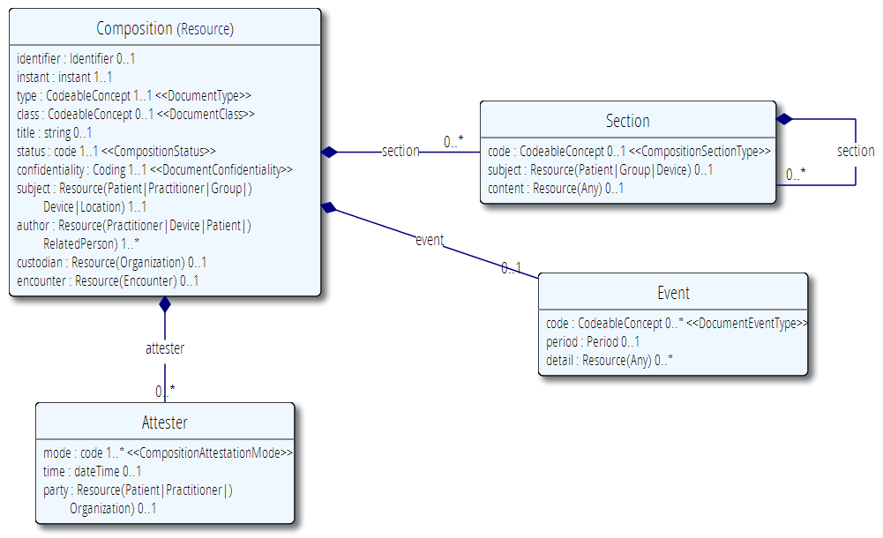
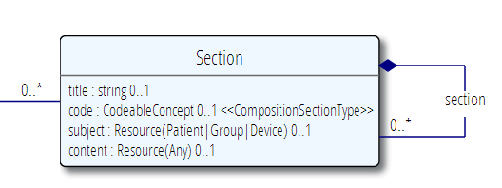
The Document resource
A single Resource, very often a List

Slide 18
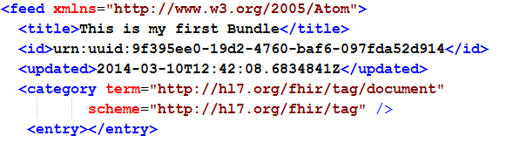
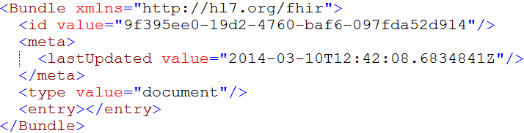
Tag as “Document”
<Bundle xmlns="http://hl7.org/fhir">
<id value="9f395ee0-19d2-4760-baf6-097fda52d914"/>
<meta>
<lastUpdated value="2014-03-10T12:42:08.6834841Z"/>
</meta>
<type value="document"/>
<entry></entry>
This Bundle is a Document

Slide 19
Bundle References
References in bundles can be:
Absolute: e.g. http://hl7.org/fhir/Patient/1
Relative: e.g. Patient/1
Relative is expressed with respect to the “base” URL declared for the bundle
Non-RESTful ids
In some cases, a resource might not exist on a RESTful server
Solution: entry base = “urn:oid” or “urn:uuid”
Resource identifier is an OID or a UUID

Slide 20
Communicating FHIR Documents

Slide 21
Mailbox
You can “drop” your document on
http://server.org/fhir/Mailbox
(or http://server.org/fhir/$mailbox)
No storage or disassembly is implied, your just posting a document in its entirety.
Servers can implement any specific functionality as required between trading partners when receiving such a document.
Notes:
* But ofcourse, some server could have functions to disassemble documents on reception. Since the contents of documents are resources, each of the contained resources (including the Document header) can be stored using the normal REST interface. But they are no longer the document anymore!

Slide 22
Document/Bundle
You can store your document using
http://server.org/fhir/Document
(now http://server.org/fhir/Bundle)
Storage, NO disassembly is implied, document (and signature) stays intact
Search is supported (you search on it’s Message header – Composition)
Notes:
* But ofcourse, some server could have functions to disassemble documents on reception. Since the contents of documents are resources, each of the contained resources (including the Document header) can be stored using the normal REST interface. But they are no longer the document anymore!

Slide 23
Transaction
You can post the document to the server’s root URL for processing as a transaction
http://server.org/fhir
All resources in the instance are created/updated individually as a single unit of work
Document id, tags and metadata are lost

Slide 24
Binary
You can base64-encode the document and post it as a Binary instance
Same as posting a PDF, CDA or any other type of file
http://server.org/fhir/Binary
Can only search by the resource id
Guaranteed to return a binary-identical (and signature-valid) instance

Slide 25
DocumentReference
Doesn’t actually store the document, just a reference to it
Useful in “shared index” models such as MHD (XDS on FHIR)
The DocumentReference can then point to the document itself – at either the Document/Bundle end-point or the Binary endpoint.

Slide 26
Custom operations
The OperationDefinition resource allows you to define custom operations
Take arbitrary data types, resource references and bundles (e.g. Documents) as parameters
Allows you to define behavior around communicating documents.
E.g. Request a referral to be “processed” by submitting a referral document

Slide 27
Is that all?
Nope - Documents can be shared any way you like
Email (secure if you’re sharing patient data!)
FTP (ditto)
SOAP
Memory stick/DVD by courier
Smoke signals . . .
FHIR defines the HTTP end-points as conveniences, not to mandate a transport solution.

Slide 28
FHIR Document Architecture Considerations

Slide 29
Document Profiles
Documents are most useful when you can define standard structures and content for them
E.g. CCDA, Oncology referral for hospital X
Profile resource allows
Defining the structure of the Composition
Slicing section for each section content
Defining the structure of all referenced resources
Identifying which resources must be/can be included in the document bundle

Slide 30
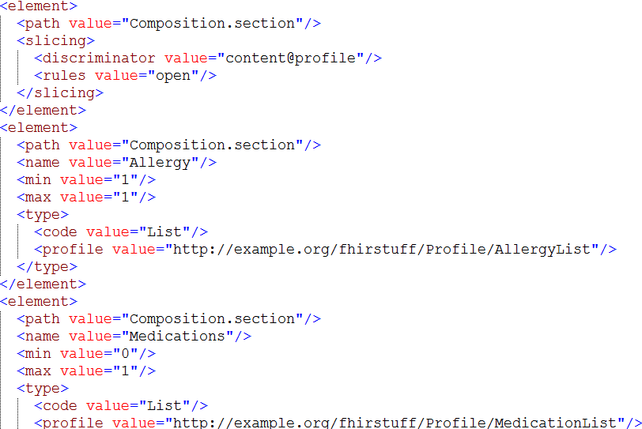
Section Slicing

Slide 31
Document persistance
There is no defined order to entries in a document other than the first
Round-tripping between persistence and XML/ JSON (or RDF) may produce different orders
Even with canonicalization, signatures may not hold if document elements are stored in their constituent parts
Therefore:
If you care about signature, store documents as a binary

Slide 32
Document Signatures
Any bundle (including Documents) can have an XML digital signature
Signatures aren’t required to use FHIR documents – other means of verifying integrity, etc. are ok too
One or more resources in a document can also be signed by including a Provenance resource.

Slide 33
Tags and security
Tags (and ‘security’ metadata) can appear on both resource entries and at the bundle level
If using security tags, must establish precedence
Safest is ‘most restrictive applies’, but business rules may differ
Tags inside document entries can’t be changed without breaking the document signature

Slide 34
FHIR Documents & the Standards Space

Slide 35
Mobile Health Data
IHE specification that leverages FHIR to implement XDS
Can index FHIR documents or any other
For that matter, XDS can index FHIR documents too . . .
IHE Concept | FHIR Resource
DocumentEntry | DocumentReference
SubmissionSet | DocumentManifest
Folder | List

Slide 36
CDA on FHIR
Project to define what “clinical documents” should look like in FHIR
Will include
Profile of the Composition resource
Mapping of CDA header to Composition
High-level mapping of root entries to possible corresponding

Slide 37
CCDA on FHIR
Project to map between CCDA and a FHIR-equivalent, including profiles
Long term vision is a new version of CCDA with exact FHIR equivalents balloted in parallel

Slide 38
CDA <-> FHIR
Some guidance can be found here:
http://hl7.org/fhir/comparison-cda.html
Or stay for Grahame’s tutorial

Slide 39


Questions?
http://hl7.org/fhir lmckenzie@gevity.com

